Slide 1
Twenty-First Century Capitalism:
The Case of Amazon
Southern Workers Assembly School
April 18, 2021

Slide 2
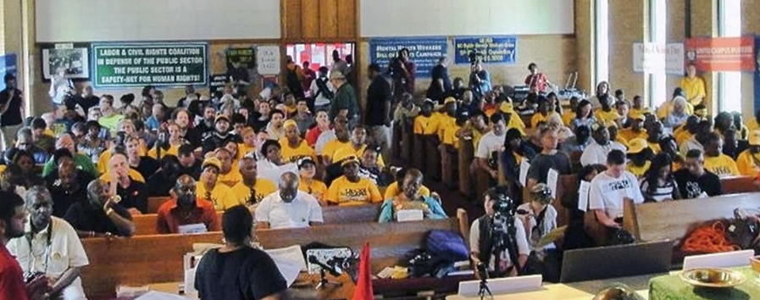
The Southern Workers Assembly (SWA) is a network of local unions, worker organizations, and organizing committees, committed to building rank-and-file democratic social movement unionism (unionism with a social justice agenda, defined by and accountable to the rank-and-file) as a foundation for organizing, uniting and transforming labor power throughout the South.
SWA Core Principles: Rank-and-file democracy; national and international labor solidarity; organizing the unorganized; fighting all forms of discrimination; building a Southern labor congress; and building labor’s power for independent political action.
SWA Core Demands: Repeal Taft-Hartley and Right-to-Work laws, and collective bargaining rights for all workers.

Slide 3
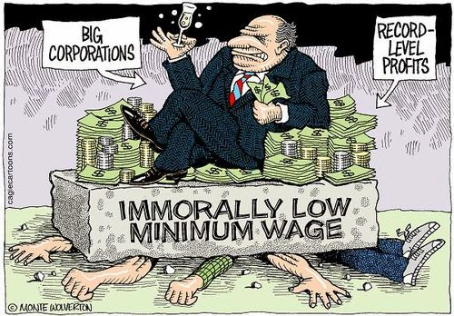
Q1: What is capital?
Is it money? NO!
It is money invested to make more money
The question is HOW

Slide 4
How does capitalism work?
Production Distribution Consumption
Amazon

Slide 5
Production requires
Tools, technology
Natural resources
Labor
The capitalist invests.
Those are fixed costs.
Workers provide labor.
Those costs vary.
Capitalists seek low wages.
Key issues:
The role of technology
The conditions of work
The scale of capital
The role of the government
The capacity of labor to fight back

Slide 6
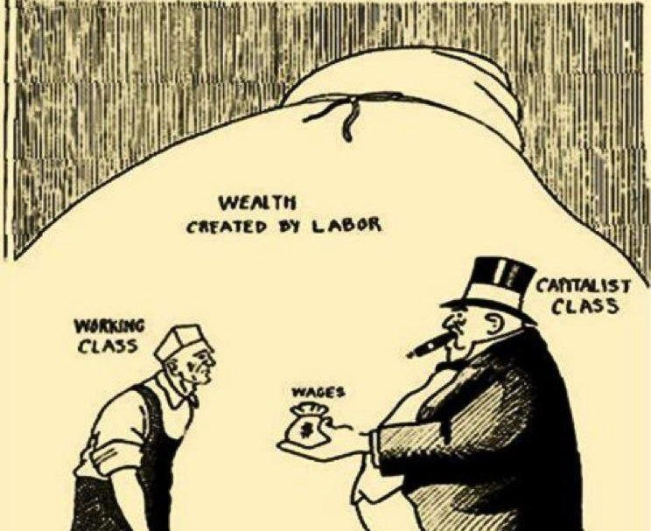

Slide 7
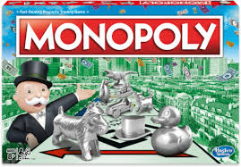
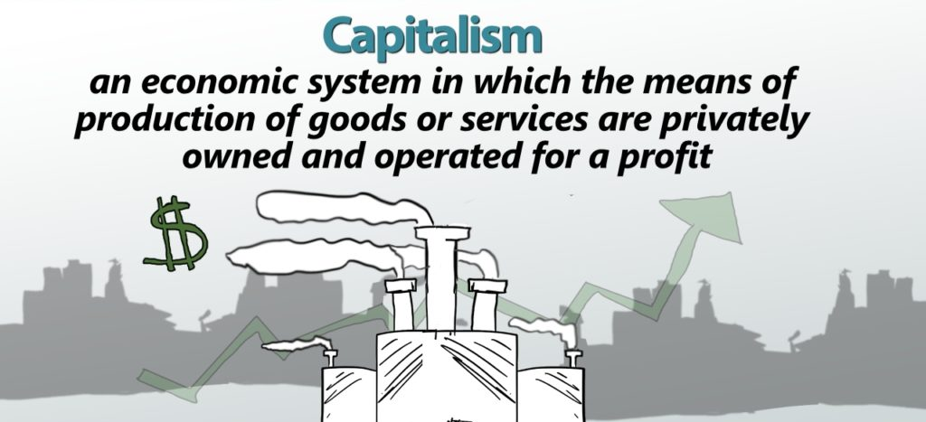
Historical context is key
17th Century:
merchant capitalism
18th Century:
small shop competitive capitalism
19th Century:
industrial, competitive capitalism
20th century:
finance, monopoly capitalism
21st century
global, AI capitalism
Amazon:$1.7 trillion
Jeff Bezos: $194.9 billion
(Richest man in the world)

Slide 8
What is new about 21st century capitalism?
AI (Artificial Intelligence)
Digital tools
Computers
Robots
Total surveillance
Global scale
Horizontal & Vertical
integration

Slide 9
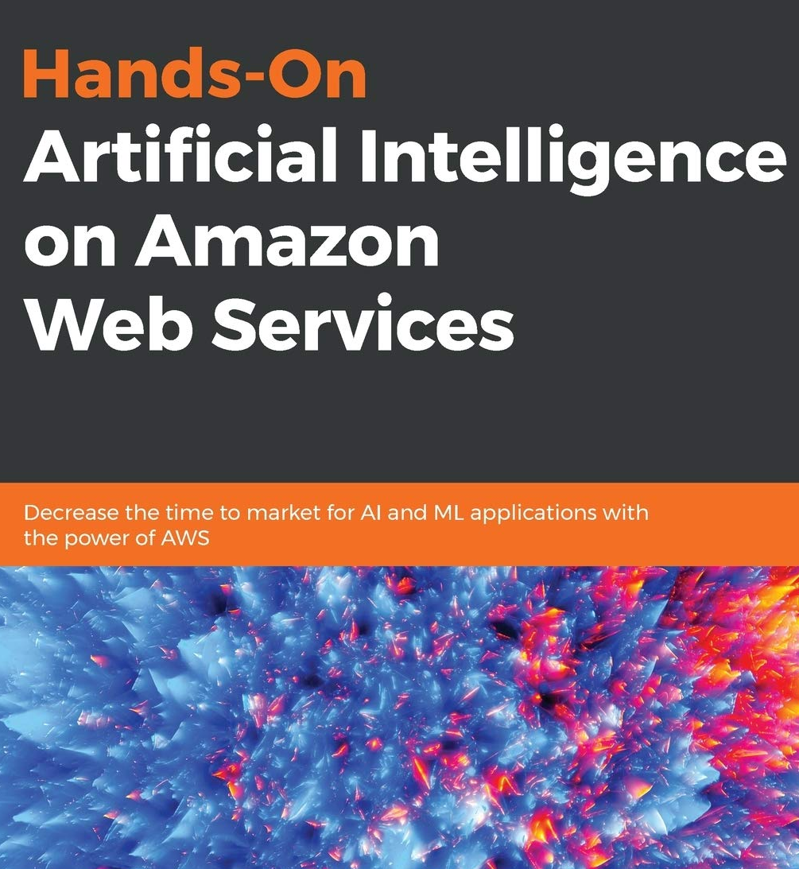
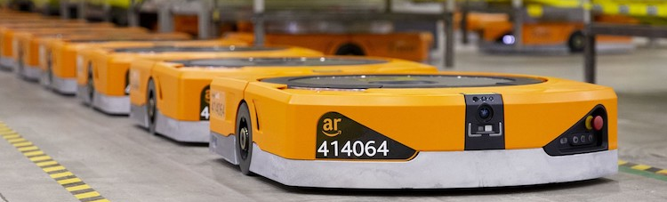
AI (Artificial Intelligence)
Digital tools
Computers
Robots
Total surveillance
Global scale
Horizontal & Vertical
integration

Slide 10
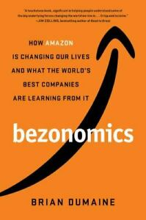
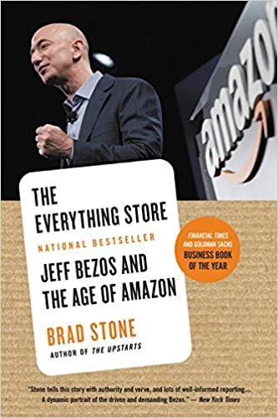
Why is Amazon the face of 21st century capitalism?
Amazon uses digital data to dominate markets and influence our behavior

Slide 11
Amazon’s board:
Capitalist corporations, government, law, and technology talent
A capitalist corporation uses its (paid) board of directors for information and working relationships with other corporations and government. Board connections are how the entire capitalist system works for the capitalist class, now on a global level. As of September 2020, the board of directors is:
Jeff Bezos, President, CEO, and Chairman
Keith B. Alexander, CEO IronNet Cybersecurity, former NSA Director
Rosalind Brewer, Group President, and COO, Starbucks
Jamie Gorelick, partner, Wilmer Cutler Pickering Hale and Dorr
Daniel P. Huttenlocher, Dean of the Schwarzman College of Computing at the Massachusetts Institute of Technology
Judy McGrath, former CEO, MTV Networks
Indra Nooyi, former CEO, PepsiCo
Jon Rubinstein, former Chairman, and CEO, Palm, Inc.
Thomas O. Ryder, former Chairman, and CEO, Reader's Digest Association
Patty Stonesifer, President, and CEO, Martha's Table
Wendell P. Weeks, Chairman, President, and CEO, Corning Inc.

Slide 12
How big could Amazon grow?
Online retail sales: $469 billion, largest in the world
Web services: AWS 47% of market, 50% of Amazon’s income
“As the global death toll from the pandemic neared one million deaths, Jeff Bezos, Amazon’s CEO, became the first person in world history to amass a personal net worth of over $200 billion, and the corporation doubled its net profit year over year to $5.2 billion. While millions of workers were laid off across the world, Amazon hired nearly 400 thousand more workers since 2019, increasing its (directly employed) workforce to over 1 million workers. For the blue-collar workers in warehousing and delivery, the pandemic exacerbated Amazon’s ‘extreme high churn model’ – the continual replacement of workers in order to sustain dangerous and gruelling work-pace demands.”
Pluto Press Blog

Slide 13
Amazon’s warehouse network

Slide 14
Amazon’s warehouse network
https://www.mwpvl.com/html/amazon_com.html

Slide 15
The Amazon strategic model – the flywheel
Use market size to squeeze competitors. Take losses to drive others out of business, then raise prices.
Use technology to control wages
Use privatized data to influence our behavior
Use market size to
squeeze sellers
Keep us ‘fulfilled’ with speed,
price, and convenience
while we give them all our
data and dollars
Become a monopoly in all aspects of business
“The flywheel, when properly conceived and executed, creates both continuity and change. On the one hand, you need to stay with a flywheel long enough to get its full compounding effect. On the other hand, to keep the flywheel spinning, you need to continually renew, and improve each and every component.” ― Jim Collins, Turning the Flywheel: A Monograph to Accompany Good to Great

Slide 16
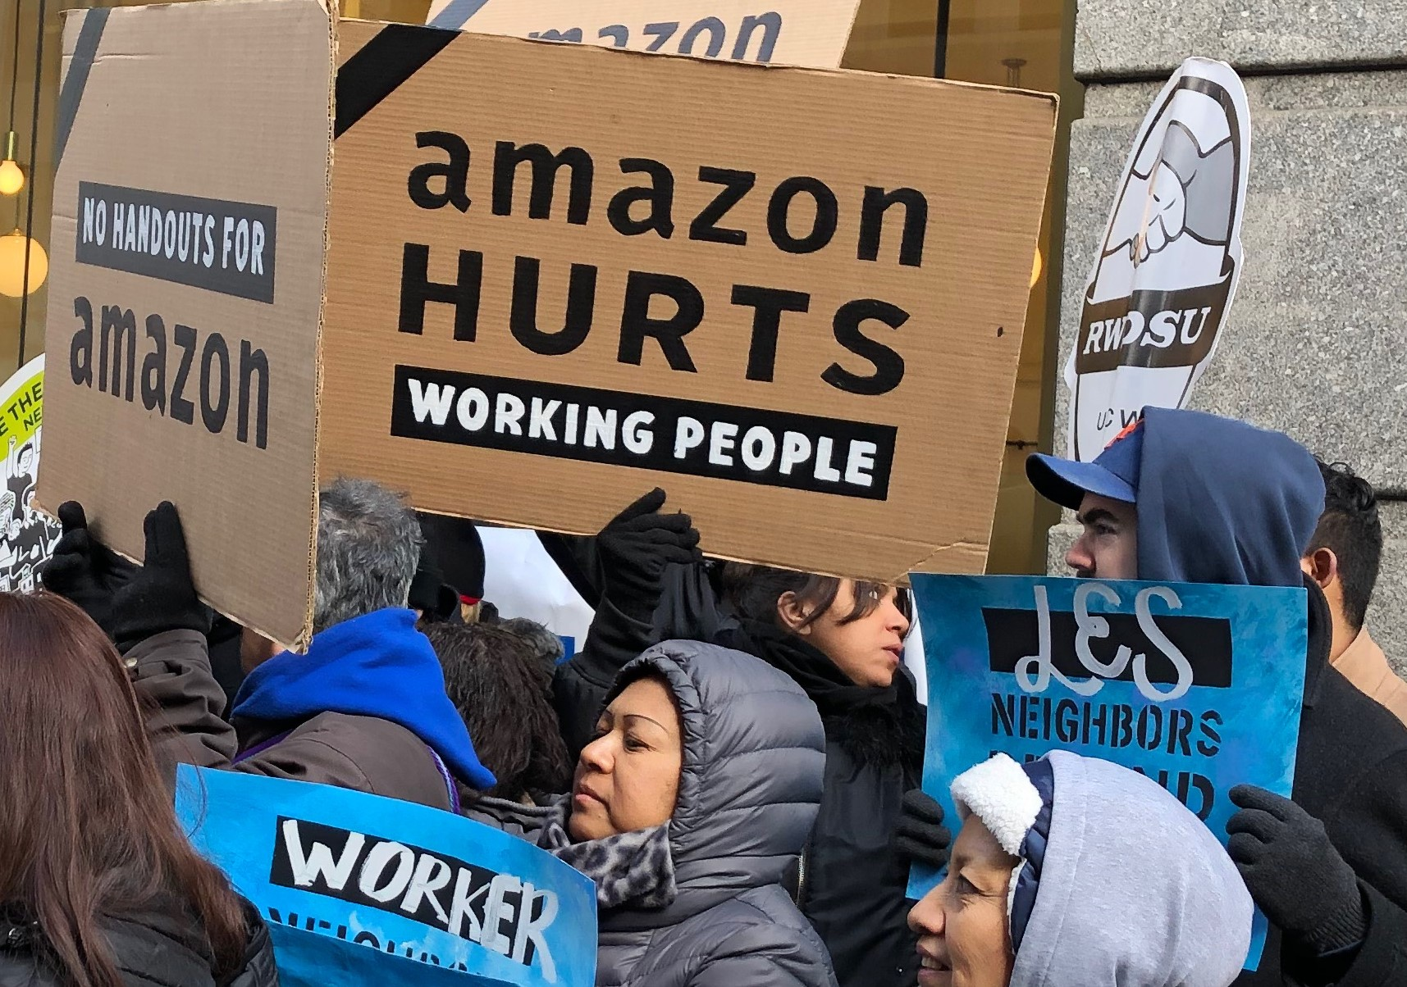
Capitalist techniques Amazon uses to get more profits from its workers
Extend workday
Speed up work
Limit break time
Hire temps
Fire without cause
Beat anti-union drum
Minute by minute surveillance and control

Slide 17
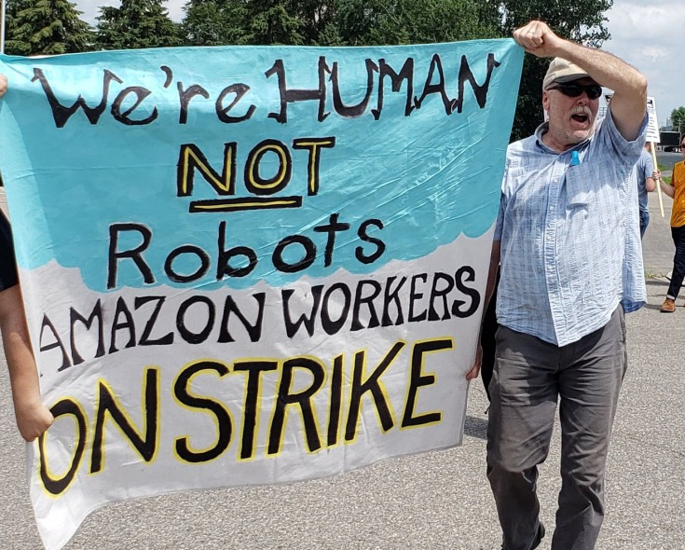
Is Amazon vulnerable? YES!
Workers can always find ways to resist and stop production
Consumers can boycott and refuse to buy
All distribution systems have chokepoints
Amazon is too big to be allowed to exist and dominate us
The people united can never be defeated

Slide 18
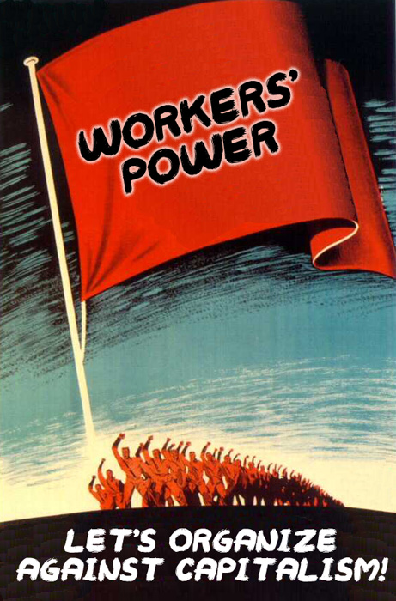
Capitalism does not exist without exploiting workers.
When we fight back, we develop our power to take control.

Slide 19
One stuck ship can halt global trade

Slide 20
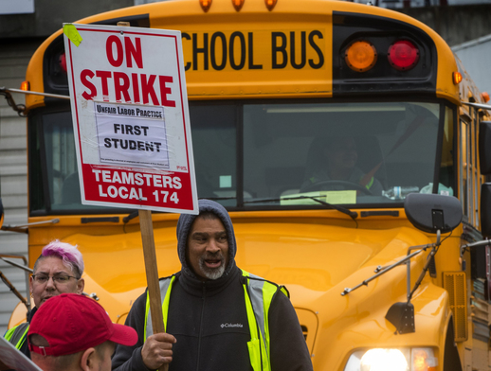
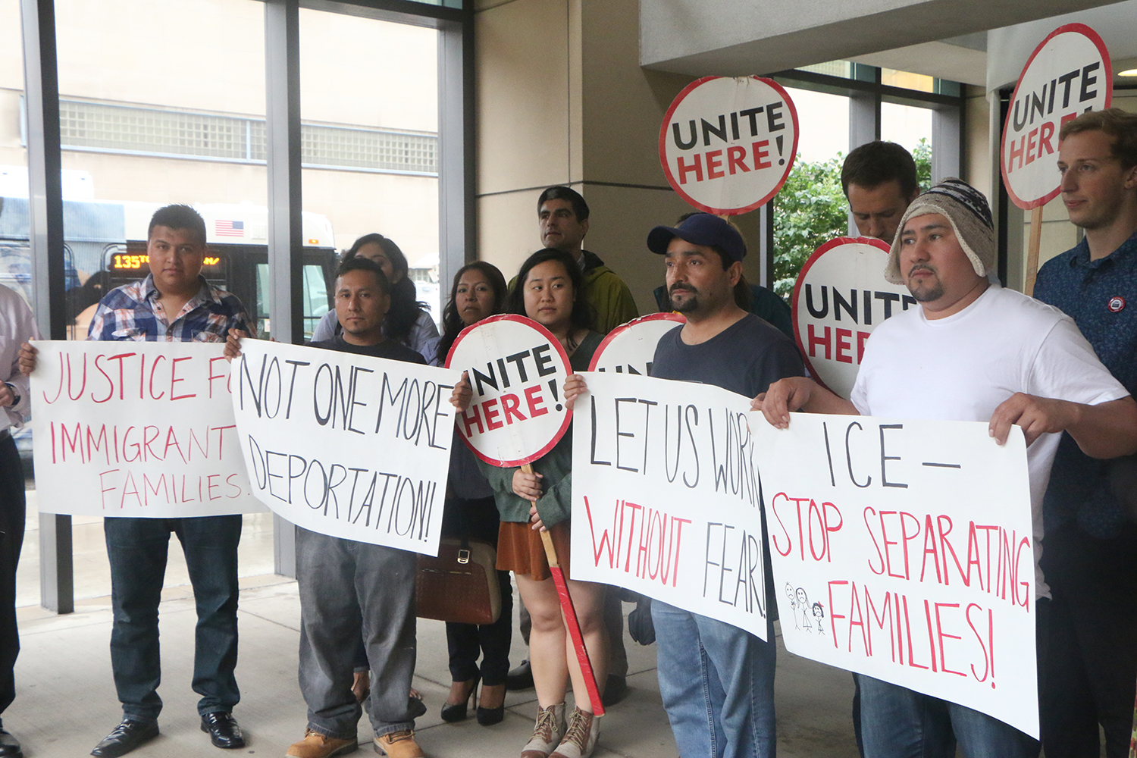
How do workers fight against capitalists?
In one workplace?
Form a union, win right to strike
In one city?
Spread unionization and community allies
As the working class?
Build mass organizations of all workers
WHERE DO YOU WORK? WHAT INDUSTRY? WHAT CITY? WHAT STATE?

